Slide 1
Design and Analysis of Algorithms CS345
Lecture 12
Depth First Search in Directed Graph - II

Slide 2
A Recapitulation of the last lecture

Slide 3


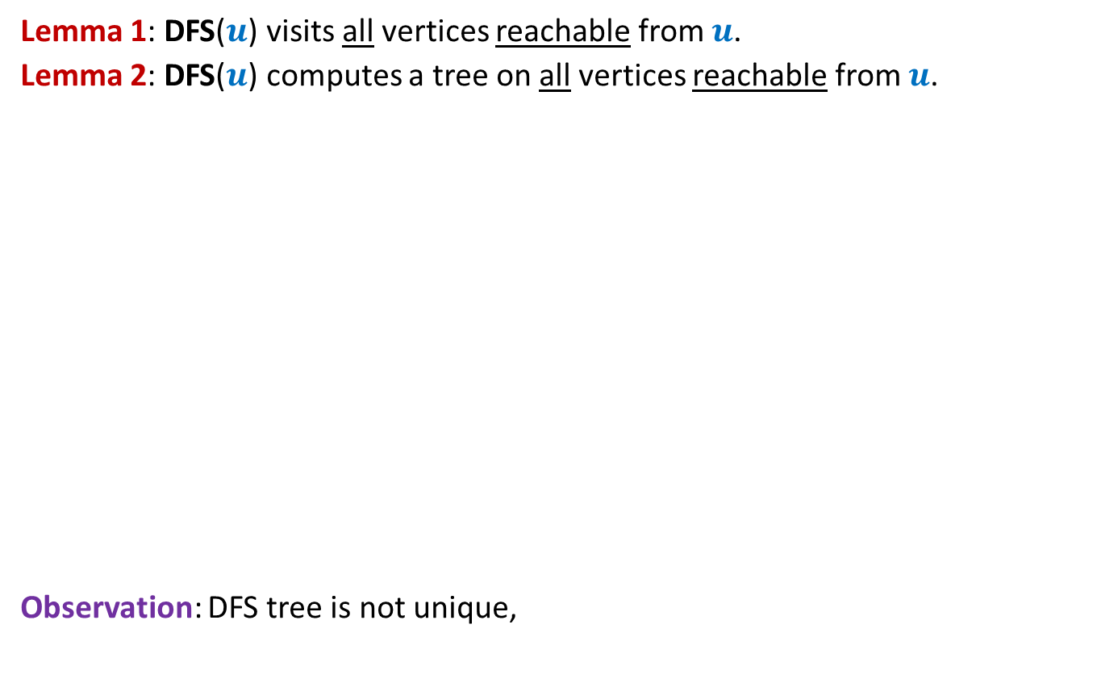
DFS from a vertex $u$
Lemma 1: DFS($u$) visits all vertices reachable from $u$.
Lemma 2: DFS($u$) computes a tree on all vertices reachable from $u$.
Observation: DFS tree is not unique,
x
y
u
s
q
w
j
r
p
v
t
but every tree is not a DFS tree

Slide 4
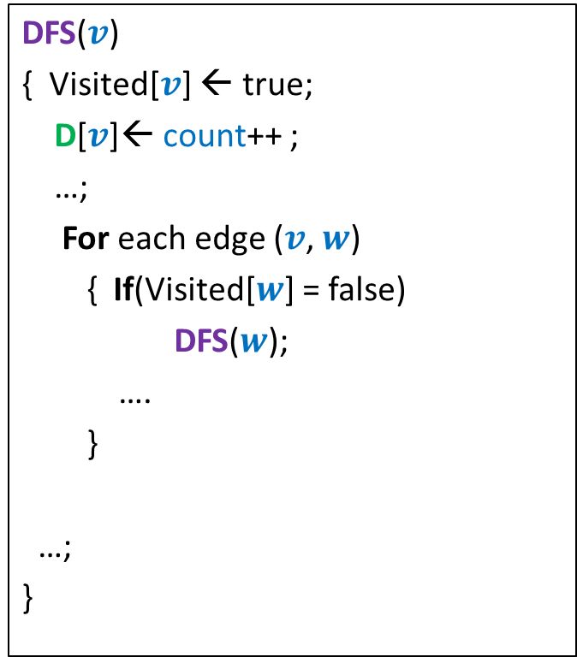

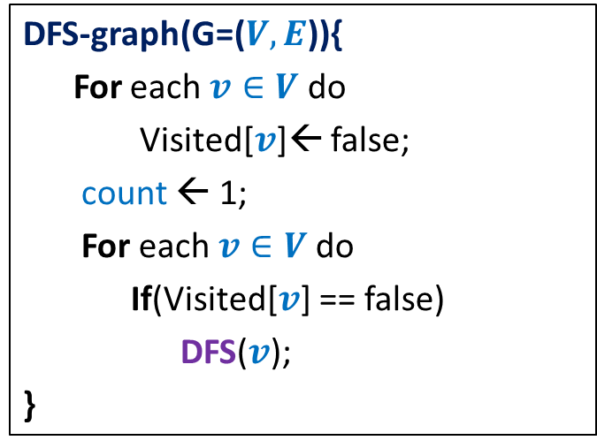
DFS on the graph
DFS($v$)
{ Visited[$v$] ← true;
D[$v$]← count++ ;
…;
For each edge ($v$, $w$)
{ If(Visited[$w$] = false)
DFS($w$);
….
}
…;
}
DFN number of v :
the time when DFS starts at v.
DFS-graph(G=($V,E$)){
For each $v∈V$ do
Visited[$v$]← false;
count ← 1;
For each $v∈V$do
If(Visited[$v$] == false)
DFS($v$);
}
F[$v$]← count++ ;
Finish number of v :
the time when DFS at v ends.
Lemma 3: DFS partitions the graph into a forest of DFS trees.
Notes:
Interestingly, adding only a few statements in the code DFS(v) leads to efficient algorithms for a variety of problems.

Slide 5
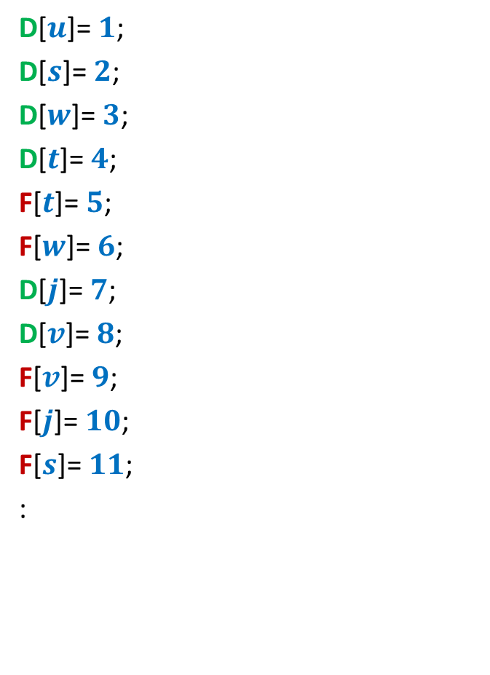
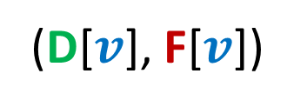
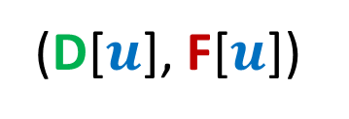
Relation between
(D[$u$], F[$u$])
and
(D[$v$], F[$v$])
D[$u$]= $1$;
D[$s$]= $2$;
D[$w$]= $3$;
D[$t$]= $4$;
F[$t$]= $5$;
F[$w$]= $6$;
D[$j$]= $7$;
D[$v$]= $8$;
F[$v$]= $9$;
F[$j$]= $10$;
F[$s$]= $11$;
:
x
y
u
s
q
w
j
r
p
v
t

Slide 6













Relation between
(D[$u$], F[$u$])
and
(D[$v$], F[$v$])
Disjoint
One enclosing another
What about
D[$u$]
F[$u$]
D[$v$]
F[$v$]
D[$u$]
F[$u$]
D[$v$]
F[$v$]
D[$u$]
F[$u$]
D[$u$] < D[$v$] <F[$u$] < F[$v$] ?
D[$v$]
F[$v$]

Slide 7
Classification of non-tree edges
using
(D[$u$], F[$u$])
and
(D[$v$], F[$v$])

Slide 8
Classification of non-tree edges
There seems to be many different types of non-tree edges.
x
y
u
s
q
Can we classify the non-tree edges ?
w
j
r
p
v
t
b
d
h
c

Slide 9
Classification of non-tree edges
x
y
u
s
q
w
j
r
p
v
t
b
d
h
c

Slide 10







($u$,$v$) is Forward edge
$$u$$
$$s$$
$$w$$
$$v$$
D[$u$]
F[$u$]
D[$v$]
F[$v$]

Slide 11

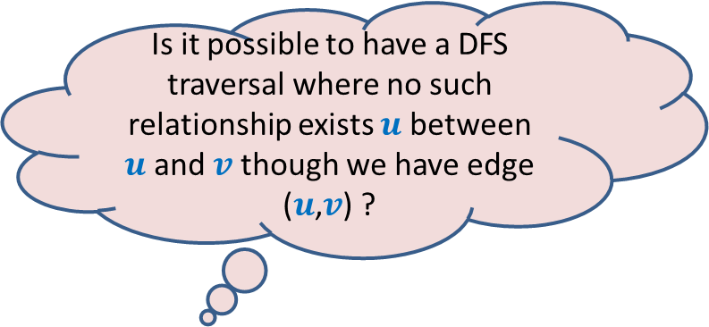









($u$,$v$) is Backward edge
Till now, we considered the situations in which either $u$ is ancestor of $v$ or vice versa.
$$v$$
$$s$$
Is it possible to have a DFS traversal where no such relationship exists $u$ between $u$and $v$ though we have edge ($u$,$v$) ?
$$w$$
$$u$$
Yes, indeed.
Think over it before moving to the next slide
D[$v$]
F[$v$]
D[$u$]
F[$u$]

Slide 12











($u$,$v$) is Cross edge
$$y$$
$$u$$
$$v$$
Is there any other type of non-tree edge ?
Think over it …
$$s$$
$$w$$
In the following slide, we shall show that these are the only possibilities of a non-tree edge.
$$x$$
D[$v$]
F[$v$]
D[$u$]
F[$u$]

Slide 13







Classification of non-tree edges
Consider an edge ($u$,$v$)
Case 1: ancestor to descendant
Case 2: descendant to ancestor
Case 3:
Tree edge or Forward edge
D[$u$]
F[$u$]
D[$v$]
F[$v$]
D[$v$]
F[$v$]
Backward edge
D[$u$]
F[$u$]
Cross edge
D[$v$]
F[$v$]
D[$u$]
F[$u$]
D[$u$]
F[$u$]
D[$v$]
F[$v$]

Slide 14
Classification of non-tree edges
x
Forward edges
(u,w)
(b,c)
y
u
s
q
w
j
r
p
v
t
b
d
h
c

Slide 15
Classification of non-tree edges
x
Forward edges
(u,w)
(b,c)
Backward edges
(t,u)
(j,u)
(r,q)
(c,b)
y
u
s
q
w
j
r
p
v
t
b
d
h
c

Slide 16
Classification of non-tree edges
x
Forward edges
(u,w)
(b,c)
Backward edges
(t,u)
(j,u)
(r,q)
(c,b)
Cross edges
(x,u)
(j,t)
(y,u)
(y,q)
y
u
s
q
w
j
r
p
v
t
b
d
h
c

Slide 17
Application - I
Checking if a directed graph is a unique-path graph

Slide 18
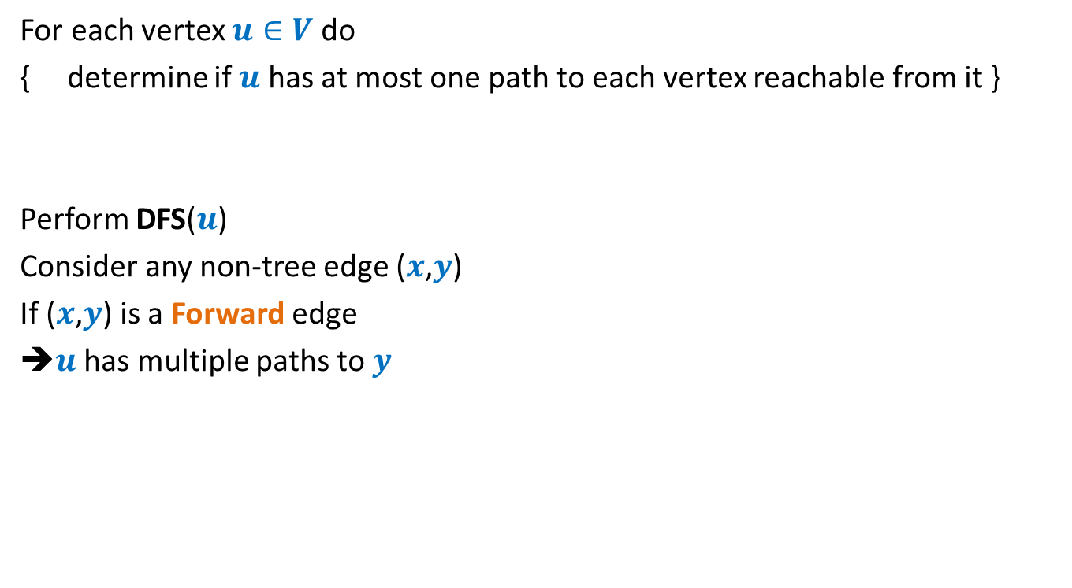

An O($mn$) time algorithm
For each vertex $u∈V$ do
{ determine if $u$ has at most one path to each vertex reachable from it }
Perform DFS($u$)
Consider any non-tree edge ($x$,$y$)
If ($x$,$y$) is a Forward edge
➔$u$ has multiple paths to $y$
a
b
u
s
q
w
j
r
p
v
t

Slide 19
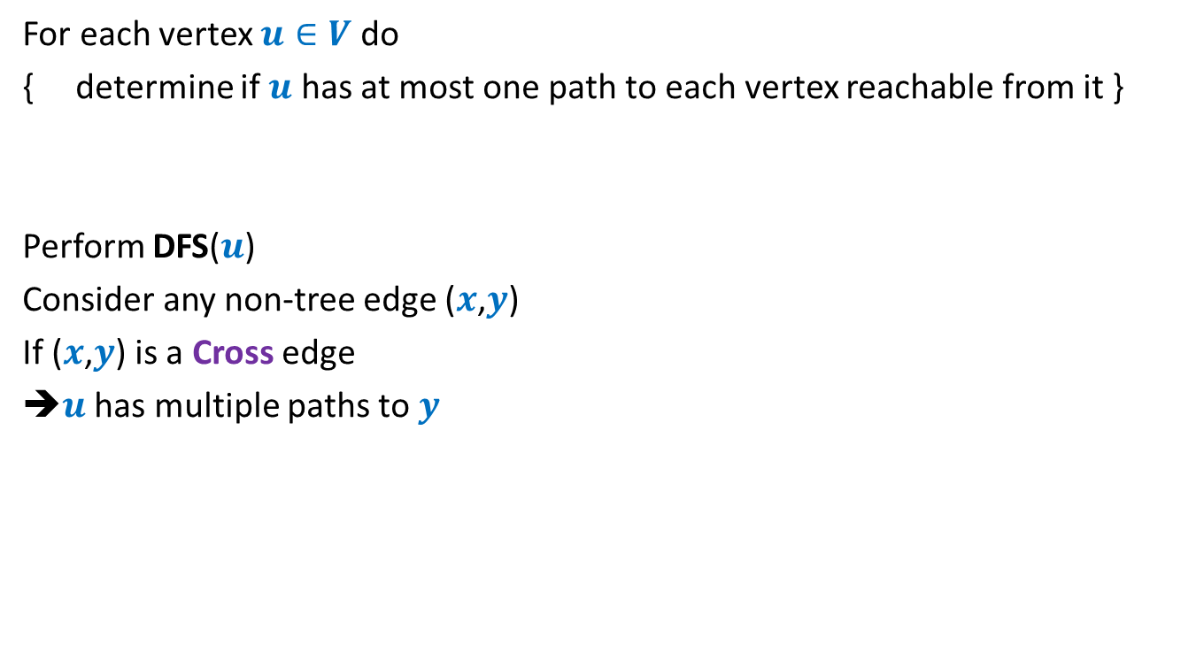
An O($mn$) time algorithm
For each vertex $u∈V$ do
{ determine if $u$ has at most one path to each vertex reachable from it }
Perform DFS($u$)
Consider any non-tree edge ($x$,$y$)
If ($x$,$y$) is a Cross edge
➔$u$ has multiple paths to $y$
u
s
q
w
j
r
p
v
t

Slide 20

An O($mn$) time algorithm
For each vertex $u∈V$ do
{ determine if $u$ has at most one path to each vertex reachable from it }
Perform DFS($u$)
Consider any non-tree edge ($x$,$y$)
If ($x$,$y$) is a Backward edge
u
s
q
w
j
r
p
v
t

Slide 21
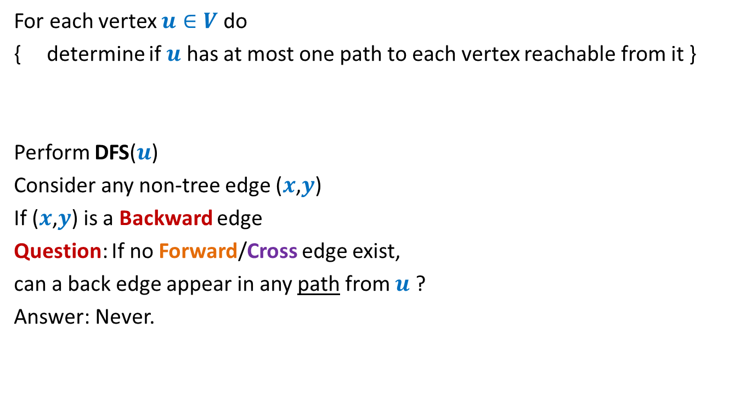
An O($mn$) time algorithm
For each vertex $u∈V$ do
{ determine if $u$ has at most one path to each vertex reachable from it }
Perform DFS($u$)
Consider any non-tree edge ($x$,$y$)
If ($x$,$y$) is a Backward edge
Question: If no Forward/Cross edge exist,
can a back edge appear in any path from $u$ ?
Answer: Never.
u
s
q
w
j
r
p
v
t

Slide 22
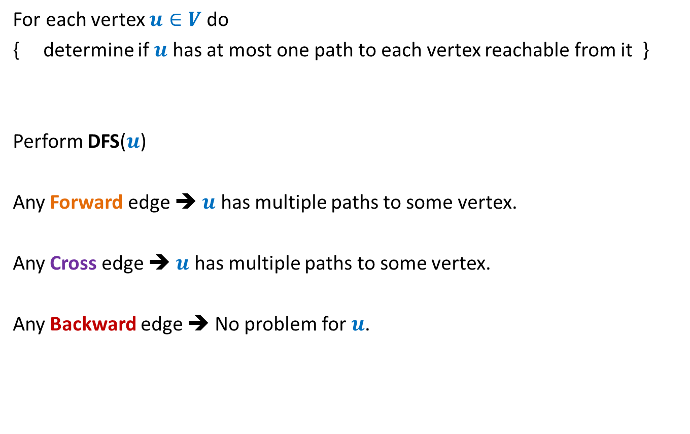
An O($mn$) time algorithm
For each vertex $u∈V$ do
{ determine if $u$ has at most one path to each vertex reachable from it }
Perform DFS($u$)
Any Forward edge ➔ $u$ has multiple paths to some vertex.
Any Cross edge ➔ $u$ has multiple paths to some vertex.
Any Backward edge ➔ No problem for $u$.

Slide 23

How to achieve O($n^{2}$) time algorithm ?
Question: Can we do just a single DFS of the graph ?
Any Forward edge ➔
Any Cross edge ➔
This explains, at least intuitively, why it is not easy to pursue a single DFS of the graph to solve this problem.
Multiple paths from the root
?

Slide 24


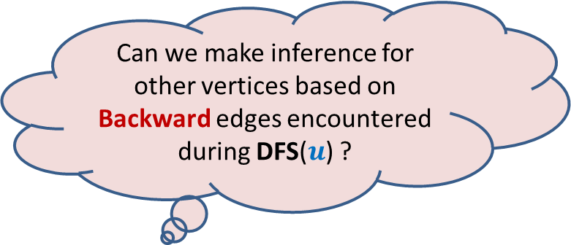
Let us revisit the O($mn$) time algorithm
Perform DFS($u$)
Any Forward edge ➔ $u$ has multiple paths to some vertex
Any Cross edge ➔ $u$ has multiple paths to some vertex
Any Backward edge ➔ No multiple paths to any vertex from $u$.
Can we make inference for other vertices based on Backward edges encountered during DFS($u$) ?

Slide 25


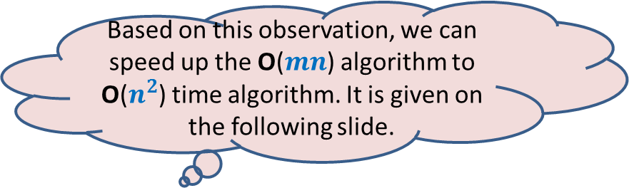
Towards an O($n^{2}$) time algorithm …
Question: How many Backward edges can emerge from a single vertex
if graph is a unique-path graph?
Answer: at most $1$
Based on this observation, we can speed up the O($mn$) algorithm to O($n^{2}$) time algorithm. It is given on the following slide.

Slide 26









Suitably augmenting DFS($v$)
DFS($v$)
{ Visited[$v$] ← true;
D[$v$]← count++ ;
…;
For each edge ($v$, $w$)
{ If (Visited[$w$] = false)
DFS($w$);
else {
If( ) …
else …
}
}
…;
}
Back-edges[$v$] ← $0$;
O($n$) time per fresh DFS ☺
Finished[$w$]
{ UniquePathGraph ← false; break }
{ Back-edges[$v$] ++;
If (Back-edges[$v$] > $1$)
{ UniquePathGraph ← false; break }
}
Finished[$v$] ← true;
F[$v$]← count++ ;
Notes:
Interestingly, adding only a few statements in the code DFS(v) leads to efficient algorithms for a variety of problems.

Slide 27
Application - II
Alternate algorithm
for topological numbering of a DAG.

Slide 28


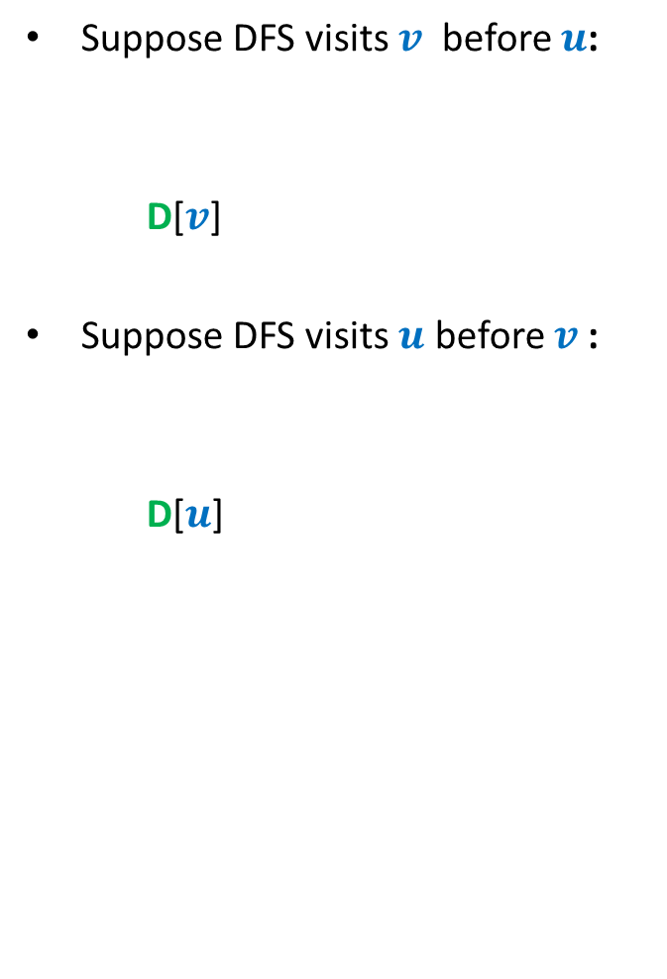



DFS on a DAG
What should you focus on ?
Do you see any relation?
Suppose DFS visits $v$ before $u$:
D[$v$]
Suppose DFS visits $u$ before $v$:
D[$u$]
An edge
< F[$v$]
< D[$u$] < F[$u$]
u
< D[$v$] < F[$v$]
< F[$u$]
v
F[$u$] > F[$v$] always !!

Slide 29
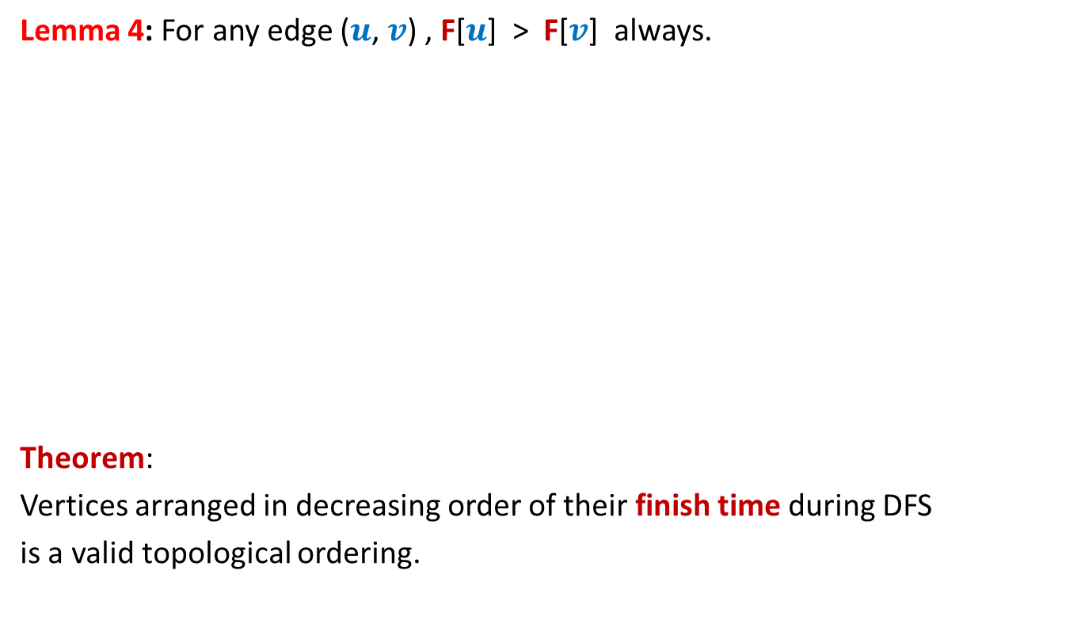
DFS on a DAG
Lemma 4: For any edge ($u$, $v$) , F[$u$] > F[$v$] always.
Theorem:
Vertices arranged in decreasing order of their finish time during DFS
is a valid topological ordering.
Decreasing order of F
1 2 3 4 5 6 7 8 9 10 11

